Slide 1
European Biobanks in the Coronavirus Pandemic
Judita Kinkorová
Department of Immunochemistry
University Hospital Pilsen
Czech Republic

Slide 2
Disclosure:
The author is not in conflict of interest

Slide 3
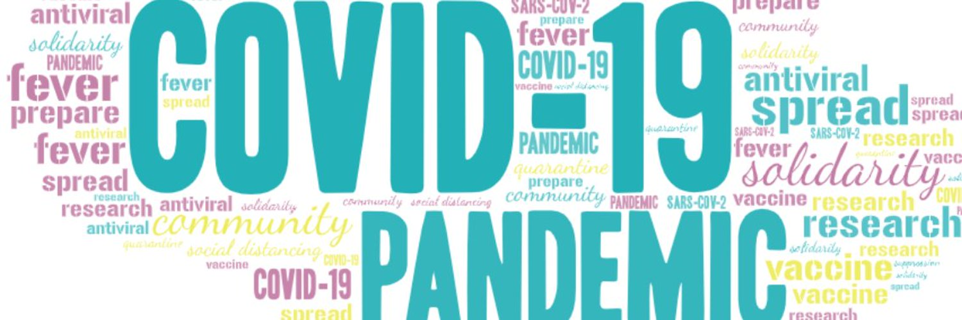
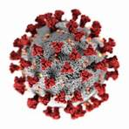
  Europe and the whole world have been facing covid-19 pandemic, new situation, nobody was prepared and ready to face
  The COVID-19 pandemic is the
  public health challenge of our time.
  A full vaccination reduces risk of SARS-CoV-2 infection by roughly 90%, and a single dose is 80% effective, according to a study of US nurses, firefighters and other front-line workers.
  A study of more than 9,500 people in Wuhan, China — once the epicentre of COVID-19 — found that only 7% of the population had been infected with SARS-CoV-2, of whom more than 80% had had no symptoms.

Slide 4
New „COVID- 19“biobanks in Europe were created as parts of just existing biobanks not well coordinated with each other and harmonised.
Polish BioBanking Center
Cellgen
Poland
Fidelis Research
  Bulgaria
Helsinki Biobank
    Finland
CRB Amazonie
    France
Tommy's National Reproductive Health Biobank (UK)
Cardiff University Biobank (CUB)
    United Kingdom

Slide 5
BBMRI-ERIC
Biobanking and BioMolecular resources Research Infrastructure - European Research Infrastructure Consortium
BBMRI-ERIC RESPONDS TO THE CORONAVIRUS PANDEMIC
resources from biobanks across Europe available for research on COVID-19
Biobanks are crucial in the run towards a COVID-19 vaccine and/or treatment. BBMRI network of 600+ biobanks provides key services to researchers:
efficient and high-quality storage of samples in clinical and research settings
samples from healthy individuals, to be used as control (collected 2-3 months before outbreak in each country)
guidance and standards for targeted identification, collection and conservation of important samples

Slide 6
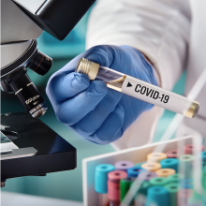
BBMRI-ERIC
Biobanking and BioMolecular resources Research Infrastructure - European Research Infrastructure Consortium
  BBMRI-ERIC
  immediately organised coordinated approach and sharing experience in „COVID -19“patient samples and
  harmonised its activities resulting in joint action sharing „COVID-19“ databases with ISBER

Slide 7
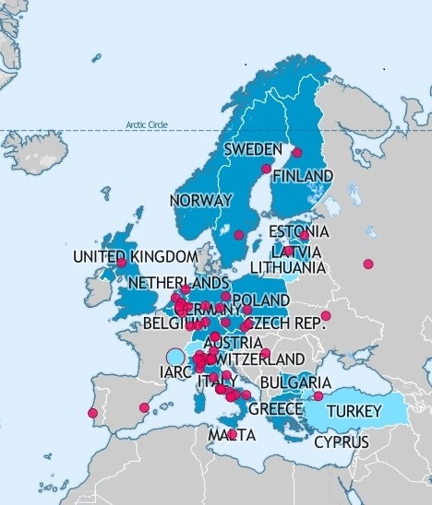
BBMRI – ERIC
Other activities
NEW COVID DIRECTORY FILTER
help to find samples and datasets applicable to research on SARS-CoV-2 and COVID-19

Slide 8
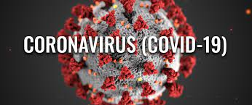
BBMRI – ERIC
Other activities
Web conferences
Biobanking in times of COVID-19
european standards for medical devices and PPE in the context of COVID-19
ELSI services & Research web conference: COVID-19 and ETHICAL, LEGAL & SOCIETAL ISSUES
COVID-19 resources from other life sciences Research Infrastructures

Slide 9
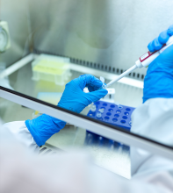
MIRRI: Active development of diagnostic tests
The Microbial Research Resource Infrastructure (MIRRI)
the biobank of human samples (ICAReB), is actively working in relation to the SARS-CoV2 outbreak.
receiving hundreds of blood samples per day from different geographical areas and institutions in France
samples are prepared, cryopreserved and distributed to Pasteurian researchers developing novel diagnostic tests, specifically serological tests.

Slide 10
CETAF and DiSSCo: Joint COVID-19
Task Force
  The Consortium of European Taxonomic Facilities (CETAF) and the Distributed System of Scientific Collections (DiSSCo)
  the understanding of the zoonotic nature of the SARS-Cov-2 and contribute to the global efforts from the perspective of both key biological properties of the virus and biological informatics
  mobilizing ad-hoc data across the 120 museums and the more than 1 billion biological specimens
  facilitating access to laboratory equipment for analysis of relevant material

Slide 11
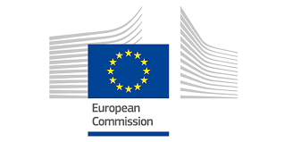

European Commission in action
May 2020
European Commission started to coordinate research activities supporting 18 projects:
improving epidemiology and public health, including European preparedness and response to outbreaks
rapid point-of-care diagnostic tests to reduce the risk of further spread of the virus
new treatments, in which a dual approach: - accelerating the development of new treatments and screening
    - identifying molecules that could work against the virus, using advanced modelling and computing techniques
development of new vaccines.

Slide 12
European Commission in action
May 2020
COVID-19 industrial cluster response portal was established
SMEs portal involved in COVID-19 was supported
Research infrastructure services to support the fight against COVID-19 were originated under umbrella of European Commission

Slide 13
European Commission in action
August 2020
European Commission followed to coordinate research activities supporting 23 projects:
Rapid repurposing of manufacturing for vital medical supplies and equipment
Medical technologies, Digital tools and Artificial Intelligence analytics to improve surveillance and care at high technology readiness levels
Behavioural, social and economic impacts of the outbreak
Pan-European COVID-19 cohorts
Collaboration of existing EU and international cohorts of relevance to COVID-19

Slide 14

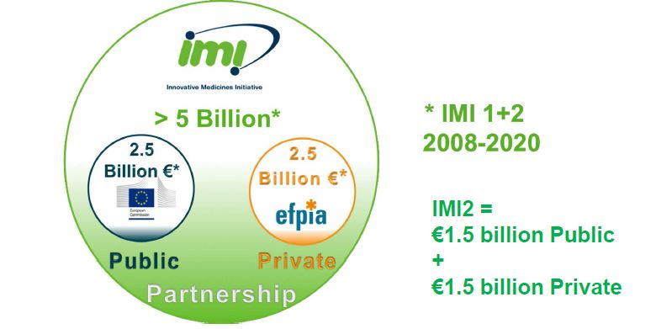
Innovative Medicines Initiative (IMI) public-private partnership funding Health Research and Innovation
launched a special fast-track call for the
“Development of therapeutics and diagnostics combatting coronavirus infections”

Slide 15
8 large collaborative projects
diagnostic tests: projects on diagnostics aim to develop devices that can be used anywhere and will deliver results very quickly, enabling front-line health workers to make the diagnosis more quickly and more accurately, which will in turn reduce the risk of further spread of the virus
new treatments

Slide 16

EFPIA is the voice of the research-based pharmaceutical industry in Europe (39 leading pharma companies). As an industry #WeWontRest in fighting the COVID-19 pandemic.
aims are to:
ensure the safe supply of medicines to the patients that need them
research and development of new vaccines, diagnostics and treatments for use in the fight against COVID-19
partner and support organisations on the ground to fight against COVID-19

Slide 17
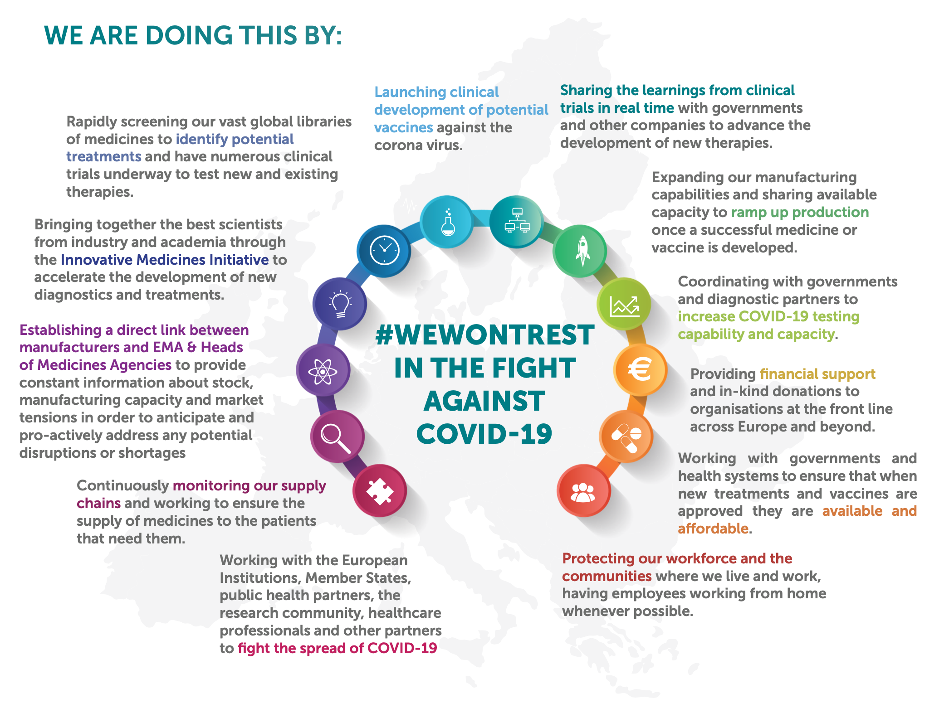

Slide 18
„thank you for sharing“ editorial
„The pandemic has highlighted long-standing, deep-rooted challenges to the sharing of biological samples…“
„…81% of researchers are constrained by the inadequate quantity and quality of biospecimens and 80% of companies find accessing materials difficult.“
„In the early months of the SARS-CoV-2 outbreak, the shortage of clinical samples that hamstrung research was compounded by the difficulty of transporting pathogenic materials across national borders. “
NATURE BIOTECHNOLOGY/SEPTEMBER 2020/ www.nature.com/naturebiotechnology

Slide 19
Thank you for your attention
Judita Kinkorová
kinkorovaj@fnplzen.cz
Funding: This work was supported by the Charles University Research Fund (Progres Q39); by the grant of Ministry of Health of the Czech Republic – Conceptual Development of Research Organization (University Hospital Pilsen – FNPl, 00669806); BBMRI-CZ: Biobank network – a versatile platform for the research of the etiopathogenesis of diseases (CZ.02.1.01/0.0/0.0/16_013/0001674); Bank of the clinical samples (LM2018125).

